Slide 1
UNIT-3
Lecture 4

Slide 2
Multicollinearity:
Multicollinearity occurs when two or more independent variables in a regression model are highly correlated with each other.
This means one predictor variable can be linearly predicted from another predictor variable with a high degree of accuracy.
It is commonly discussed in regression analysis, especially in models like Linear Regression and Logistic Regression.

Slide 3
Multicollinearity is a statistical phenomenon where independent variables are strongly correlated, making it difficult to determine the individual effect of each variable on the dependent variable.
Example:
Predicting house price using:
House size
Number of rooms
House area in square feet
Here size and number of rooms may be strongly correlated, causing multicollinearity.

Slide 4
Why Multicollinearity is a Problem:
When multicollinearity exists:
Regression coefficients become unstable
Model interpretation becomes difficult
Standard errors increase
Small data changes may cause large coefficient changes

Slide 5
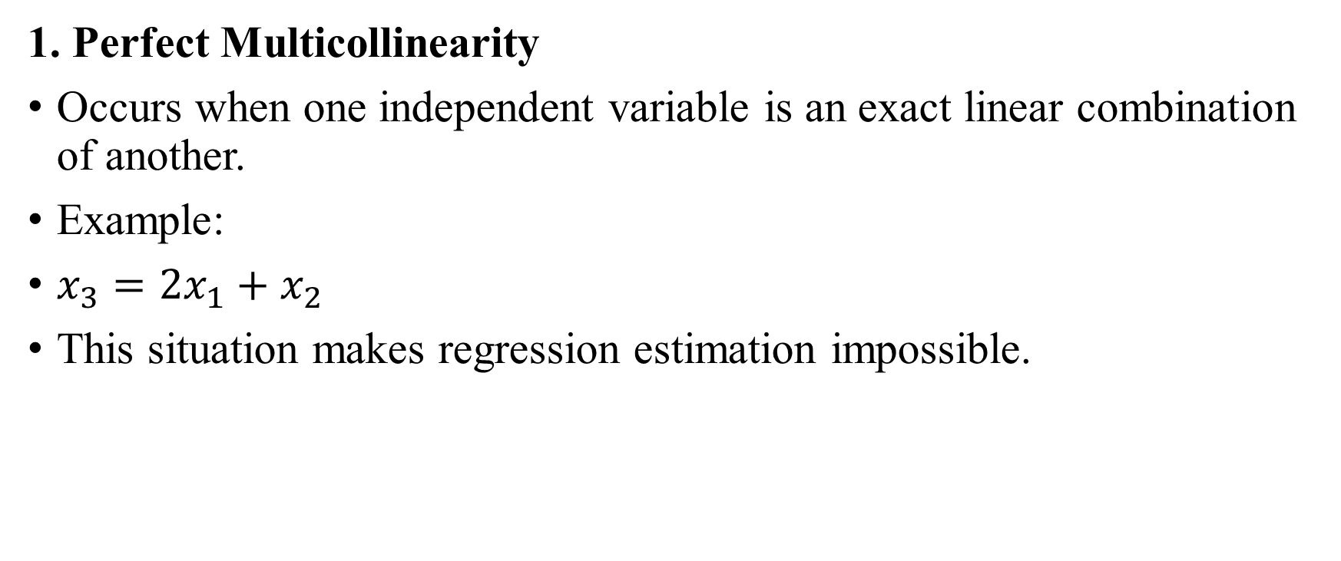
Types of Multicollinearity:
1. Perfect Multicollinearity
Occurs when one independent variable is an exact linear combination of another.
Example:
$x_{3}=2x_{1}+x_{2}$
This situation makes regression estimation impossible.

Slide 6
2. Imperfect Multicollinearity
Occurs when independent variables are highly correlated but not perfectly.
Example:
Income and expenditure may be highly correlated.

Slide 7
Detecting Multicollinearity:
Correlation Matrix
Heatmap Visualization
Variance Inflation Factor (VIF)

Slide 8
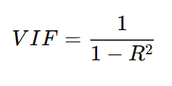
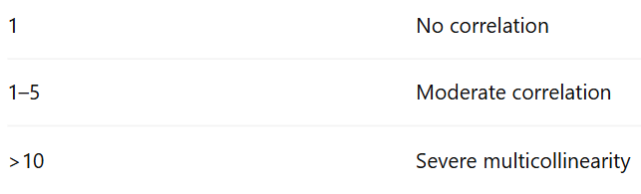
Variance Inflation Factor (VIF):
The most common method to detect multicollinearity.

Slide 9
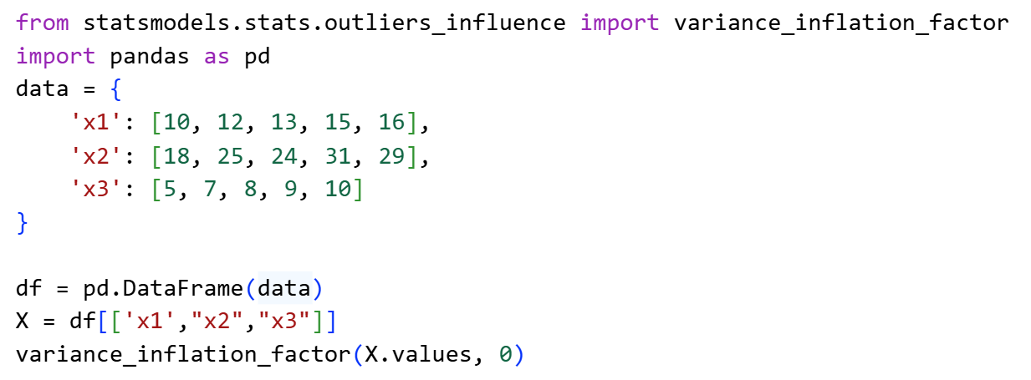

Slide 10
Effects of Multicollinearity:
Multicollinearity can cause:
Large variance of coefficients
Difficulty in identifying important predictors
Reduced model interpretability
Unstable regression estimates

Slide 11
Methods to Handle Multicollinearity:
Remove Highly Correlated Variables
Feature Selection
Principal Component Analysis (PCA)
4. Regularization Techniques: Algorithms such as:
Ridge Regression
Lasso Regression
can reduce multicollinearity effects.

